Slide 1
M2S-CGM: A Detailed Architectural Simulator for Coherent CPU-GPU Systems
Christopher E. Giles† and Mark A. Heinrich‡
†Department of Electrical and Computer Engineering
‡ Department of Computer Science
University of Central Florida, FL, USA
christopher.e.giles@knights.ucf.edu
heinrich@cs.ucf.edu

Slide 2
Outline
Part One:
Background in CPU-GPU heterogenous systems
Introduction of M2S-CGM
M2S-CGM validation
Part Two:
Coherent CPU-GPU heterogenous system implementation methodology
Experimental results
Discussion and observations
Future work

Slide 3
CPU-GPU Heterogeneous System Background
A Typical CPU
A Typical GPU
P0
P1
P2
P3
CU0
CU1
CU2
CU3
CU4
CU5
CU6
CU7
MIMD architecture
Out-of-order processors running single threads
Higher IPC
Good for sequential and thread parallel tasks
Shared virtual memory based system
SIMD architecture
In-order compute units running thread blocks
Single instruction at a time.
Good for data parallel, thread multiple tasks
Discrete memory system, physically disparate I/O device

Slide 4
CPU-GPU Heterogeneous System Background
The goal is to tightly decompose a given application into its thread parallel and data parallel segments and then parallelize over the best processor for the job.
The current model…
The application configures and sets up the GPU's execution code and data elements prior to the execution of a selected kernel on the GPU.
The application must copy data back and forth from the GPU's memory address space to the CPU's address space.
The current model incurs significant overhead.
Complexity, system calls, data copies, kernel setup, etc.
In theory, we should be able to obtain higher speed ups at the system level over the currently achievable! But how…?

Slide 5
Introducing M2S-CGM
So, to answer that question, we built a simulator to explore the CPU-GPU heterogeneous system design space and see if we can unlock these potential performance gains.
Developed CGM; our detailed custom memory system model.
Models detailed memory system structures and coherence protocols for the CPU and GPU.
Models the switching fabric, system agent (Intel termed “uncore”), memory controller, and other ancillary components.
Borrowed and modified Multi2Sim’s x86 CPU model, Southern Islands GPU model, and OpenCL software stack.
Actually, any CPU or GPU model can connect to CGM.
Borrowed DRAMSim2’s SDRAM model.

Slide 6
Salient Features Unique to M2S-CGM
Provides baseline results for both non coherent and coherent CPU-GPU heterogeneous executions in a fully modeled system with and without shared lower level caches between the CPU and GPU.
Includes CGM which provides a significantly detailed memory system for both the CPU and GPU; models system wide occupancy and contention and includes modeling of system elements, such as a detailed MESI protocol, configurable cache structures, cache directories, translation lookaside buffers, page table walkers, switching fabrics, system agents, memory controllers, GPU hub and IOMMU, and the SDRAM model.
Provides emulation and timing models for intra CPU-GPU system functionality that would otherwise typically require a full system simulator. Provides fidelity comparable to a full system simulator, but without the development overhead of implementing and supporting a full system simulator.

Slide 7
M2S-CGM Validation
For validation we utilized the Rodinia OpenMP and OpenCL benchmarks.
Backprop, Lower Upper Decomposition, Kmeans, Hotspot, Needleman–Wunsch, and Breadth First Search.
This set provides a good spectrum of processor intercommunication aggressiveness for OpenMP executions and a good spectrum of inter-CPU-GPU-communication through GPU kernel invocations and memory copies for OpenCL executions.
For OpenCL, we define the beginning of the parallel section to be the first OpenCL-related memory buffer creation and the ending of the parallel section to be the completion of the final memory copy to the host device.
Problem sizes range from medium to large.

Slide 8
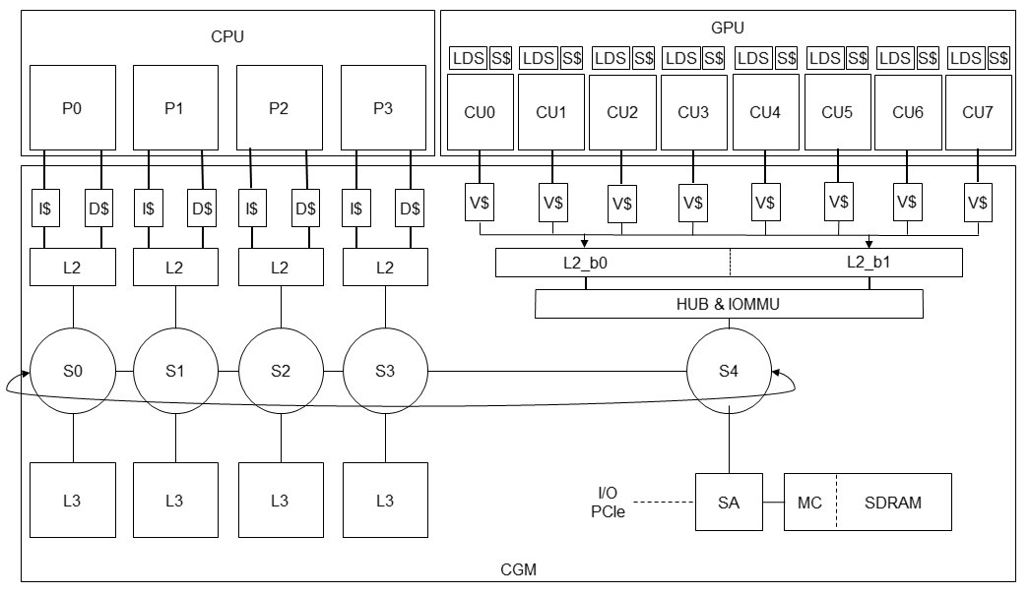
Simulation Configuration

Slide 9
M2S-CGM Validation
We compared M2S-CGM to our test system comprising an Intel Core i7-4790K Devil's Canyon Quad-Core and AMD Radeon HD 7990 64 CU GPU.
We configure M2S-CGM as shown in the previous slide and to match our test system's hardware profile.
M2S-CGM and test system frequencies for the CPU, GPU, and memory system are 4GHz, 1GHz, and 2GHz respectively.
For M2S-CGM, the system-wide cache block size is 64B with 8 byte headers.
CPU L1, L2, and L3 cache sizes are 32KB, 256KB, and 2 MB respectively. L3 caches are striped.
GPU vector and L2 cache sizes are 16KB and 64KB respectively.
Main memory is configured as dual channel with 4GB SDRAM.

Slide 10
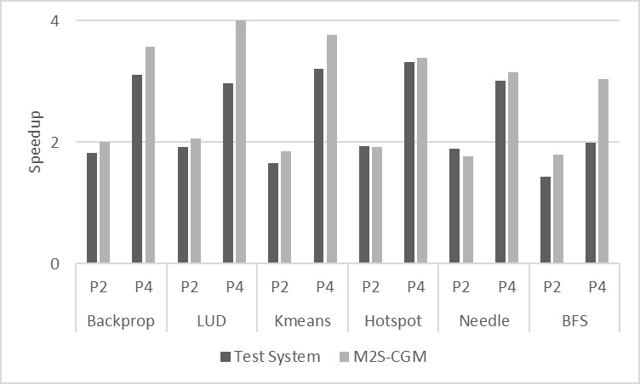
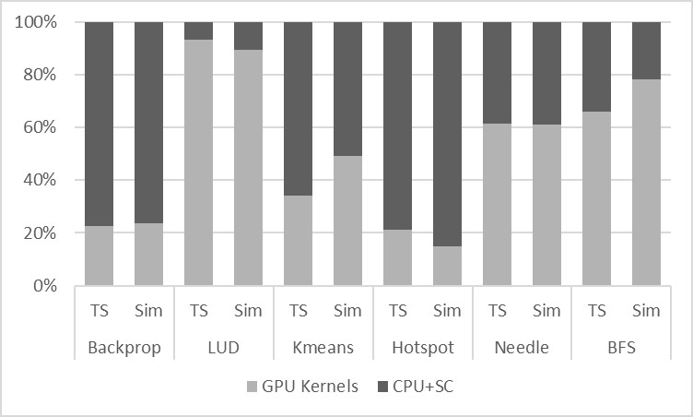
Validation Results
Results show close correlation relative to the test system.
For the OpenMP benchmarks, simulated execution had an average difference of 10.4% for the two threaded runs and 22% for the four threaded runs.
For the OpenCL benchmarks, simulated execution time breakdown between the CPU and GPU is within 6.4% on average.

Slide 11
CPU-GPU Heterogeneous System Implementation Methodology
We implemented four CPU-GPU heterogeneous system configurations using M2S-CGM for our initial experiments.
A traditional GPGPU configuration with the CPU and GPU operating in disparate virtual address spaces and disparate memory systems (used for validation).
A modified traditional GPGPU configuration with the CPU and GPU operating in disparate virtual address spaces, but with shared lower level caches.
A potential half CPU-GPU heterogeneous configuration with the CPU and GPU operating in a shared virtual address space, but disparate memory system.
A potential full CPU-GPU heterogeneous configuration with the CPU and GPU operating in both a shared virtual address space and with shared lower level caches.

Slide 12
CPU-GPU Heterogeneous System Implementation Methodology
Required modifications concern the entire software stack and underlying hardware.
Software
We configure the OS, GPU driver, and OpenCL runtime such that the CPU and GPU can operate in a shared virtual address space and share data.
We configure our OpenCL benchmarks and runtime to pass memory by pointer to the GPU from the CPU.
Hardware
We introduce memory system coherency between the CPU and GPU and implement a GPU specific MEI protocol.
Extend the GPU’s L2 caches to support protocol based block forwarding (3 way hops).
Extend memory system coherence directories to account for the entire GPU as an nth core.
We introduce the hardware mechanisms necessary to support virtual memory into the GPU’s memory system (TLBs, etc).

Slide 13
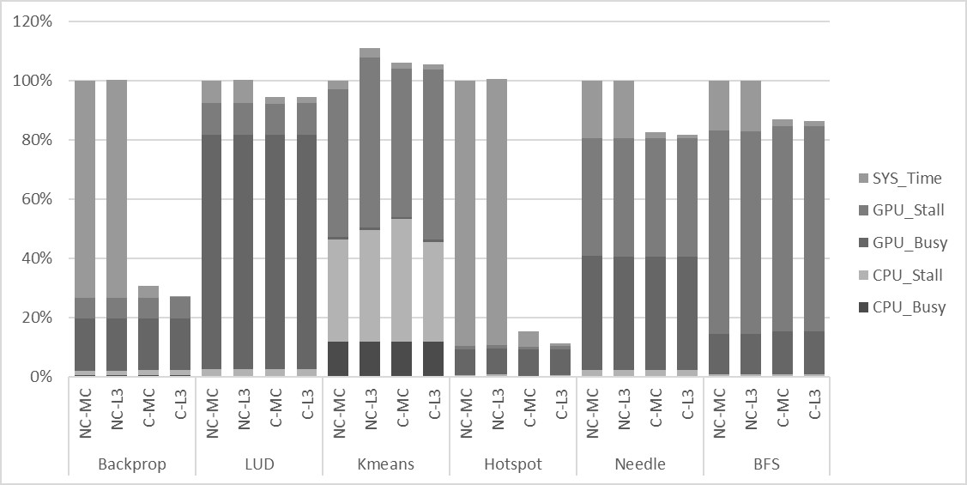
Experimental Results
CPU-GPU heterogeneous system measured speedups:
Half coherent 3.27, 1.06, 0.94, 6.51, 1.21, and 1.19
Fully coherent 3.67, 1.06, 0.95, 8.83, 1.23, and 1.40

Slide 14
Discussion
From the results it is apparent that:
The extent to which speedup is achievable is dependent on the amount of overhead incurred by the application.
Allocation of work to the CPU is nonexistent. The current Rodinia OpenCL Benchmarks do not fully exploit the complete level of parallelism available between the CPU and GPU.
In noncoherent configurations sharing the L3 caches between the CPU and GPU is ineffective and actually slightly hurts overall performance. This is due to the streaming nature of the GPU and low temporal reuse of memory system blocks.
However, in the heterogeneous configuration shared L3 caches can provide a measurable performance boost due to the coherence protocol, where GPU cache flushes are no longer required on account of the supported request forwarding between the CPU and GPU, i.e. just let it run.

Slide 15
CPU-GPU Heterogeneous System Observations
The CPU and GPU should share a single virtual address space. By sharing a single virtual address space underlying mechanisms like memory copies between the CPU and GPU are no longer required and higher levels of parallelism can be obtained through traditional synchronization and coherency mechanisms.
GPU address translation mechanisms need to be researched more. The current IOMMU approach incurs significant overhead as we must trap back to the CPU to solve address translation issues. The GPU should be capable of resolving address translation issues on its own (future work).
Current benchmarks do not fully exploit the complete level of parallelism available between the CPU and GPU. The Rodinia OpenCL benchmarks effectively delegate all processing to the GPU while the CPU mostly remains idle. In an ideal system the CPU would effectively be load balanced with the GPU and share 50% of the runtime's busy time. New benchmarks that take advantage of shared data in a fully coherent CPU-CPU heterogeneous environment are needed.

Slide 16
Future Work Utilizing M2S-CGM
We first plan to perform research regarding load balancing workloads over the entire system in order to fully utilize the coherent heterogeneous system’s parallel processing potential.
Ideal system results gain a 50/50 balance of busy time between the CPU and GPU.
Theoretically leads to new levels (2x range) of achievable speed up.
Utilize a load balanced system to perform research in architectural studies.
What happens in regards to contention, occupancy, and bandwidth in these systems?
Is there an ideal system design or core to CU ratio?

Slide 17
Conclusion
In this paper we introduced M2S-CGM.
We presented the motivation and need for M2S-CGM and provide in-depth details about its software architectural makeup.
We provided a validation of M2S-CGM’s multithreaded and heterogeneous system simulation capabilities.
We utilized the Rodinia OpenCL Benchmarks and conducted experiments over four noncoherent and coherent heterogeneous system configurations.
Our experimental results show the potential for coherent heterogeneous systems and provides new directions for future research.
M2S-CGM is made available for public use as free software for future research purposes. Current versions of CGM and M2S-CGM can be found on GitHub.

Slide 18


Q&A

